Slide 1
RECAP
Last Session

Slide 2
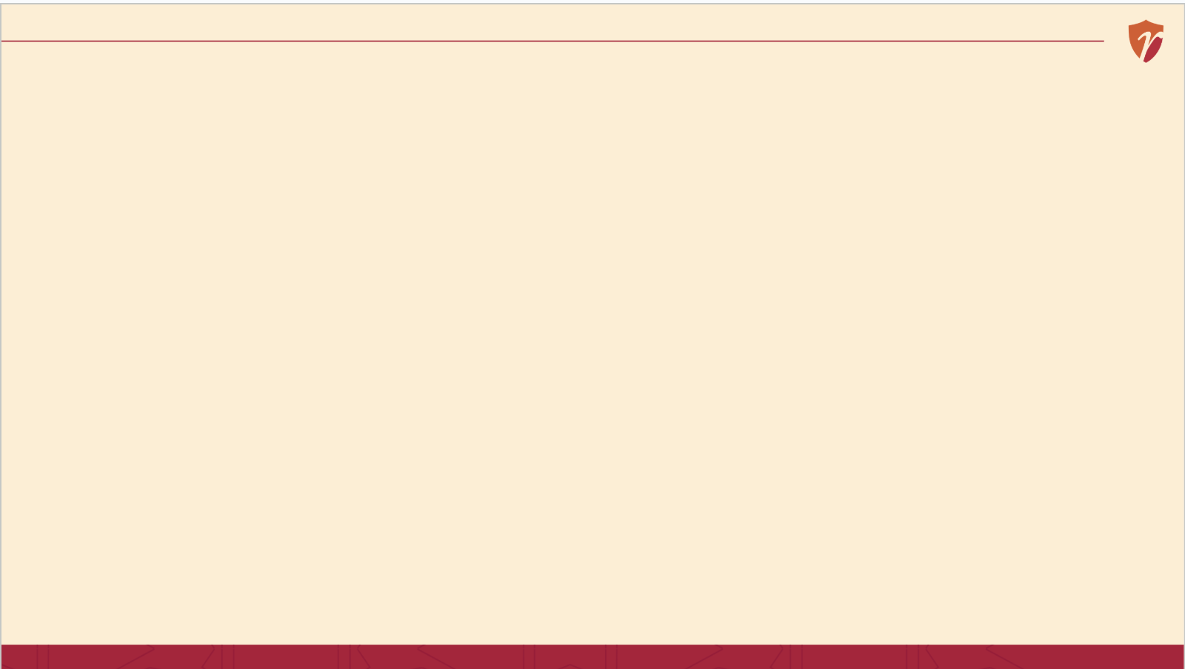
RECAP
Last Session, in 60 Seconds
Good strategy involves real trade-offs deliberately choosing what NOT to do
Strategy must fit both the outside environment and your own capabilities
Execution matters as much as the plan itself often more
Today: the actual process strategy follows, from idea to result.
4 / 15

Slide 3
LEVEL 1 OF 3
What Is Corporate-Level Strategy?
Based on: A. Nag, Strategic Management: Analysis, Implementation and Control, Ch. 1.
6 / 15

Slide 4
LOOKING AHEAD
Strategy
Corporate
SBU / Business
Functional
Which businesses should we even be in?
How do we win within one specific business?
How does each department support that win?
We'll dig into each of these deeply next session.
Framework based on: A. Nag, Strategic Management: Analysis, Implementation and Control, Ch. 1.
11 / 15

Slide 5
A STORY TO START
One Group, Many Businesses, Different Questions
The top of the house
Tata Group decides which industries to be in at all — steel, cars, software, watches and jewellery through Titan, and many more.
Inside one business
Titan itself then decides how to actually win inside the watch and jewellery markets — against HMT, against family jewellers.
Inside one department
Titan's marketing team decides how to advertise; its operations team decides how to run factories — each supporting the same fight, from a different angle.
Illustrative framing based on Tata Group's and Titan Company's publicly documented, diversified business structure.
5 / 15

Slide 6
LEVEL 1 OF 3
What Is Corporate-Level Strategy?
The question: Which businesses should we even be in?
Decided by the very top of an organization — whether to enter, exit, or expand into entirely different industries.
Example
Tata Group's decision to be in steel, cars, IT services, and consumer lifestyle products all at once, under one umbrella.
Based on: A. Nag, Strategic Management: Analysis, Implementation and Control, Ch. 1.
6 / 15

Slide 7
LEVEL 2 OF 3
What Is SBU-Level Strategy?
The question: How do we actually win inside this one business?
SBU stands for Strategic Business Unit — one distinct business within a larger group, competing in its own specific market.
Example
Titan deciding how to compete on trust and design against traditional family jewellers — a question specific to the jewellery business, not Tata Group as a whole.
Based on: A. Nag, Strategic Management: Analysis, Implementation and Control, Ch. 1.
7 / 15

Slide 8
LEVEL 3 OF 3
What Is Functional-Level Strategy?
The question: How does each department support that win, day to day?
The narrowest level — marketing, operations, finance and HR each make their own choices that ladder up to the SBU's strategy.
Example
Titan's marketing team choosing which festival campaigns to run; its operations team deciding how to staff each store — functional choices, in service of the bigger fight.
Based on: A. Nag, Strategic Management: Analysis, Implementation and Control, Ch. 1.
8 / 15

Slide 9
PUTTING THEM TOGETHER
Three Levels, Side by Side
Corporate | SBU | Functional
Which businesses to be in | How to win in one business | How each department helps
Tata Group's portfolio choice | Titan vs. family jewellers | Titan's marketing campaigns
Decided by top leadership | Decided by business-unit heads | Decided by department heads
Based on: A. Nag, Strategic Management: Analysis, Implementation and Control, Ch. 1.
9 / 15

Slide 10
BACK TO TITAN
SBU-Level Decisions Inside a Corporate Umbrella
Tata Group's corporate decision: be in watches and jewellery at all, through Titan.
Titan's SBU-level decisions within that: introducing certified purity and transparent pricing to win customer trust away from generations-old family jewellers — a choice specific to competing in jewellery, made by the people running that business, not by Tata Group's top leadership directly.
History based on widely documented accounts of Tanishq's trust-building strategy (purity certification, transparent pricing).
10 / 15

Slide 11
BACK TO MOMOS
Do Small Businesses Have Levels Too?
“Corporate”
Should Boncho open a second cart, or add a delivery-only kitchen?
“SBU”
How does the momo cart itself compete on taste and price?
“Functional”
How does she plan ingredient purchases and staff shifts?
Even a one-person business makes decisions at all three levels — just without the fancy titles.
“Priya's Momos” is a fictional business created for classroom illustration only.
11 / 15

Slide 12
CLASS DISCUSSION · 5 MINUTES
Which Level Made This Decision?
“We are shutting down our least profitable business unit entirely.”
“Our sales team will start following up with customers within 24 hours.”
“We will now offer both a budget and a premium version of our product.”
Illustrative examples for classroom discussion — no external source.
12 / 15

Slide 13
WHY THIS MATTERS
Why Founders Need to Know Which Level They're At
1
A corporate-level mistake (entering the wrong business) is far more expensive to undo than a functional one
2
Investors and co-founders often disagree because they're arguing about different levels without realizing it
3
As your business grows past one person, someone has to own each level clearly
13 / 15

Slide 14
CORE CONCEPT 1
The Strategic Management Model: Four Stages

Slide 15
CORE CONCEPT 1
The Strategic Management Model: Four Stages
1
2
3
4
Planning
Formulation
Implementation
Evaluation
Look outward and inward before deciding anything
Design the actual strategy
Put the strategy into action
Check if it's working, and adjust
It's a cycle, not a straight line — evaluation often sends you back to scanning again.
Framework based on: A. Nag, Strategic Management: Analysis, Implementation and Control, Ch. 1.
6 / 15

Slide 16
A STORY TO START
How Boncho Actually Decided to Add Delivery
She noticed something
Rainy days meant fewer customers walking to her cart, but her friends kept asking if she delivered.
She thought it through
Could afford a delivery bag and a bit of extra staff time? Would nearby hostels actually order enough to be worth it?
She tried it, then watched closely
She started with just two hostels, tracked orders weekly, and only expanded once it was clearly working.
Without knowing it, Priya just walked through all four stages of the strategic management model.
“Priya's Momos” is a fictional business created for classroom illustration only.
5 / 15

Slide 17
STAGE 1 OF 4
Planning
Looking outward and inward before making any big decision.
Outward: what are customers, competitors, and the broader market doing? Inward: what can we actually afford, staff, and support well?
For Boncho
Noticing rainy-day drop-offs and repeated delivery requests — that's scanning in action.
Based on: A. Nag, Strategic Management: Analysis, Implementation and Control, Ch. 1.
7 / 15

Slide 18
STAGE 2 OF 4
Strategy Formulation
Designing the actual response turning what you learned into a real choice.
This is where you weigh options, consider trade-offs, and commit to one direction over the alternatives.
For Boncho
Deciding to test delivery with just two nearby hostels first, instead of the whole neighbourhood at once.
Based on: A. Nag, Strategic Management: Analysis, Implementation and Control, Ch. 1.
8 / 15

Slide 19
STAGE 3 OF 4
Strategy Implementation
Putting the plan into action where most of the real work actually happens.
This is where the policies, programs, procedures and budgets we learned last week come to life the tools that make a strategy actually run day to day.
For Boncho
Buying a delivery bag, telling regulars, and actually running orders for two weeks.
Based on: A. Nag, Strategic Management: Analysis, Implementation and Control, Ch. 1.
9 / 15

Slide 20
STAGE 4 OF 4
Evaluation & Control
Checking whether it's actually working and being willing to change course.
Without this stage, a business keeps doing something long after it's stopped working. This stage often sends you straight back to scanning again.
For Broncho
Tracking weekly delivery orders — and only expanding to more hostels once the numbers clearly justified it.
Based on: A. Nag, Strategic Management: Analysis, Implementation and Control, Ch. 1.
10 / 15

Slide 21
BACK TO PRIYA'S MOMOS
Her Delivery Decision, All Four Stages
Planning
Noticed rain drop and delivery requests
Formulation
Chose to test with 2 hostels, not the whole area
Implementation
Bought a delivery bag, ran it for 2 weeks
Evaluation
Tracked orders, then expanded once it worked
“Priya's Momos” is a fictional business created for classroom illustration only.
12 / 15

Slide 22
SUMMARY
Key Takeaways from Today
Corporate-level strategy decides which businesses to be in at all
SBU-level strategy decides how to win inside one specific business
Functional-level strategy decides how each department supports that win
Even a single small business makes decisions at all three levels
14 / 15

Slide 23
SUMMARY
Key Takeaways from Today
The strategic management model has four stages: scan, formulate, implement, evaluate
It's a cycle, not a straight line — evaluation often restarts the process
Even Priya's small delivery decision followed all four stages
Strategy exists at three levels: corporate, SBU, and functional — our focus next session
13 / 15

Slide 24
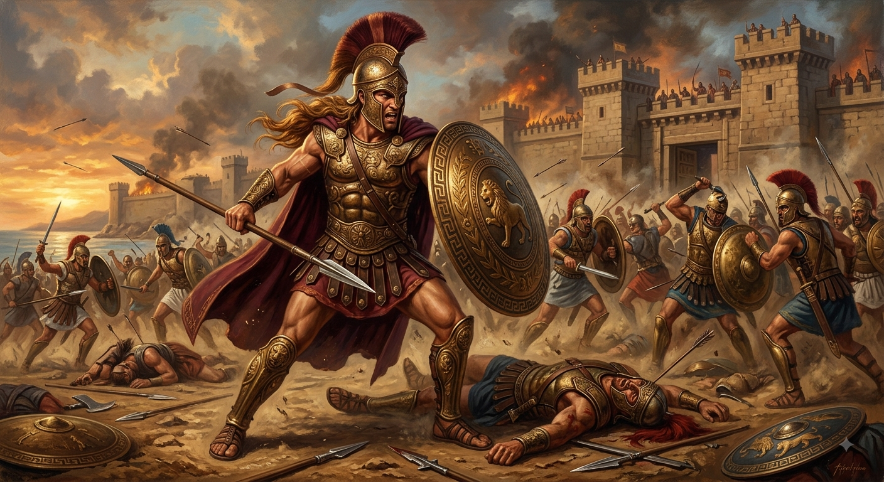
Term Of the day
Schwerpunkt
Achilles

Slide 25
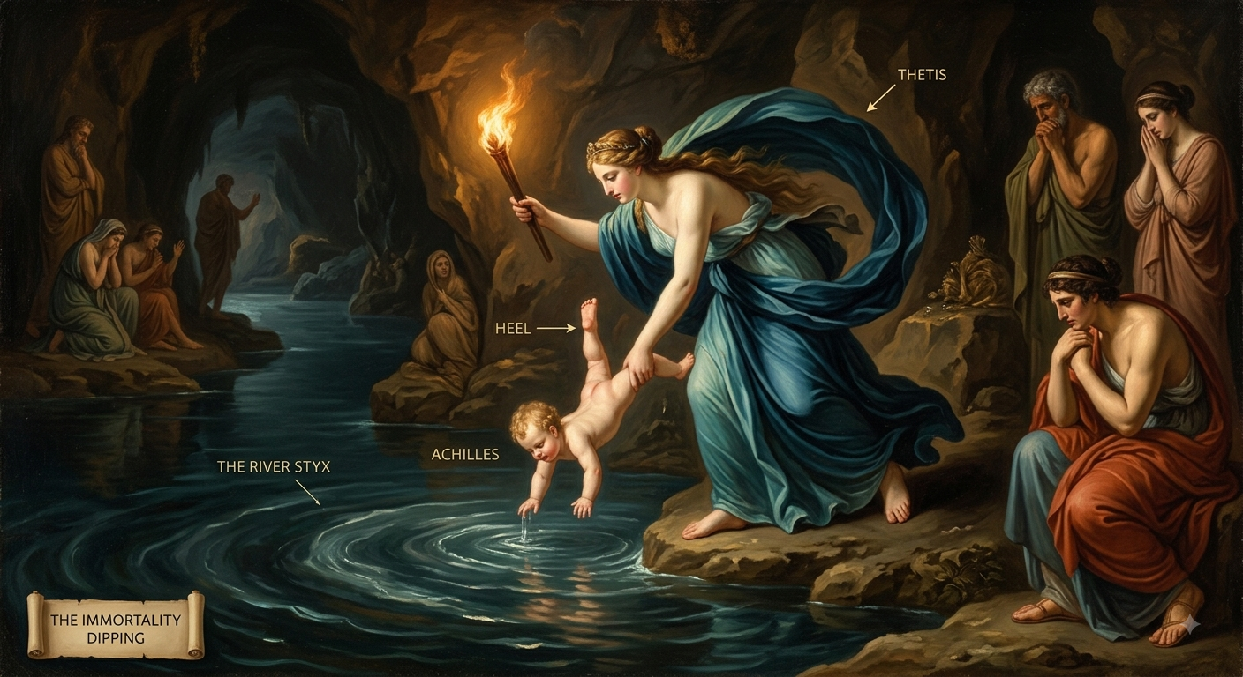
Term Of the day
Schwerpunkt

Slide 26
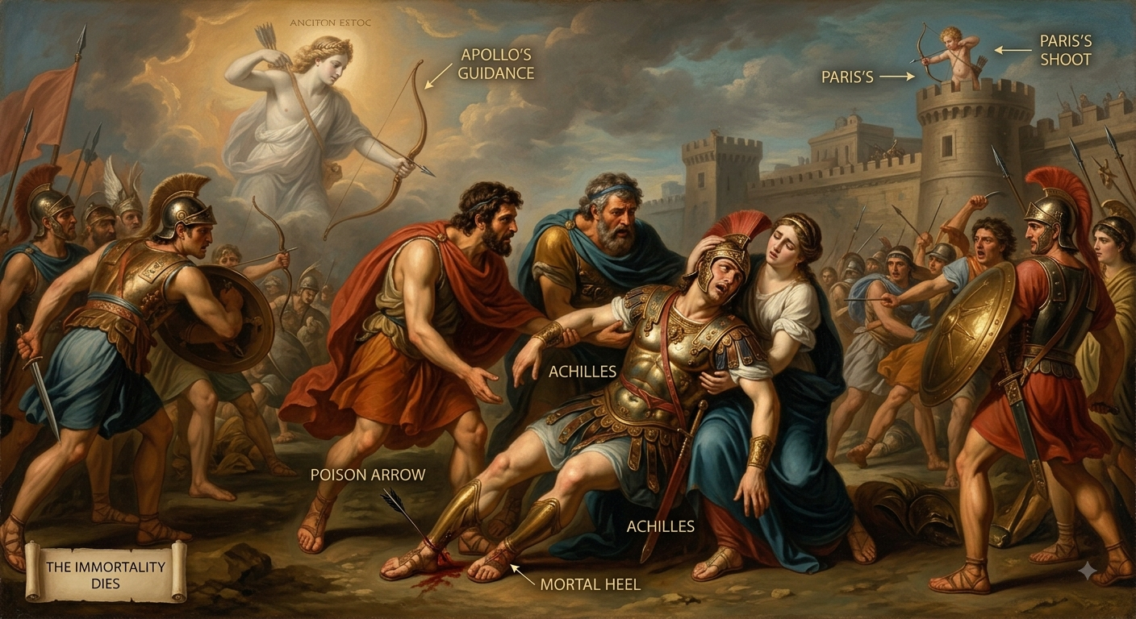
Term Of the day
Schwerpunkt

Slide 27
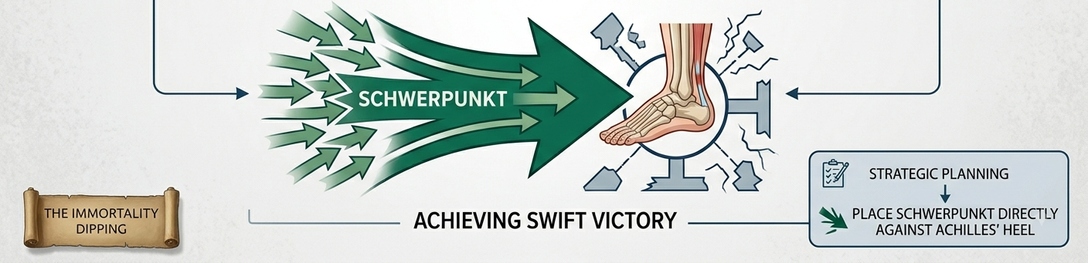
Term Of the day
Schwerpunkt
Focal Point or Center of Gravity

Slide 28
Term Of the day
Schwerpunkt
Similarly, all organizations have Achilles heel.

Slide 29
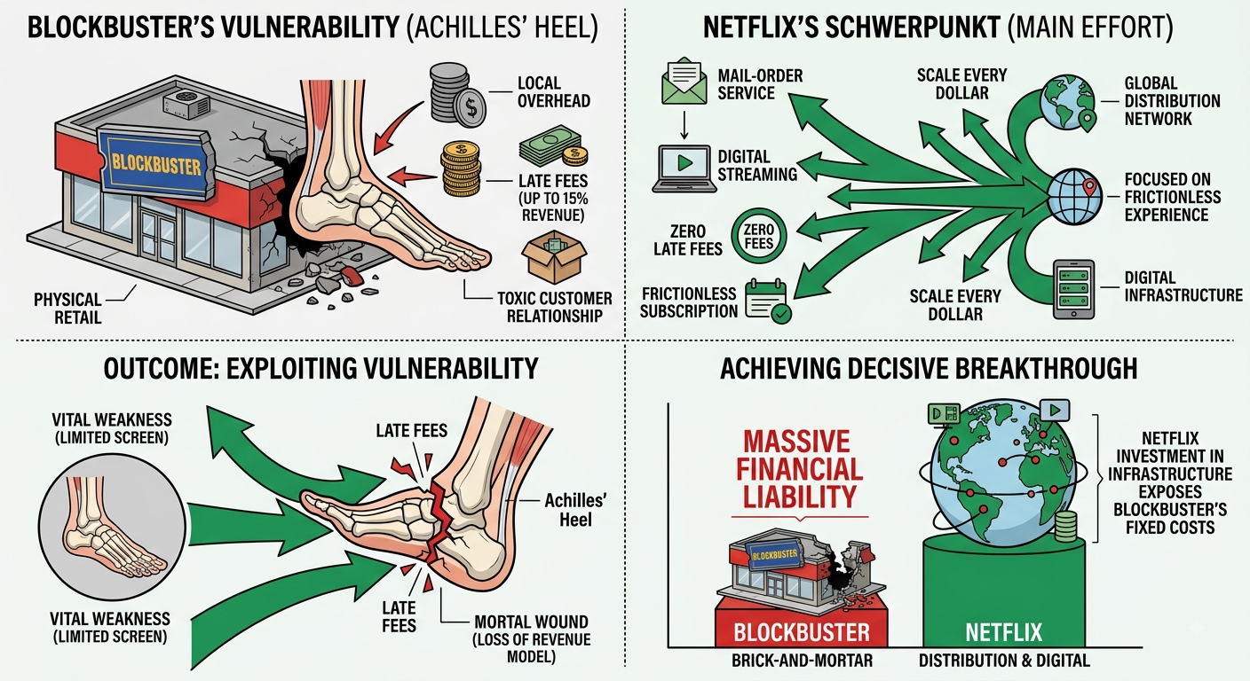
Term Of the day
Schwerpunkt

Slide 30
Term Of the day
Schwerpunkt

Slide 31
Term Of the day
Schwerpunkt

